Slide 1
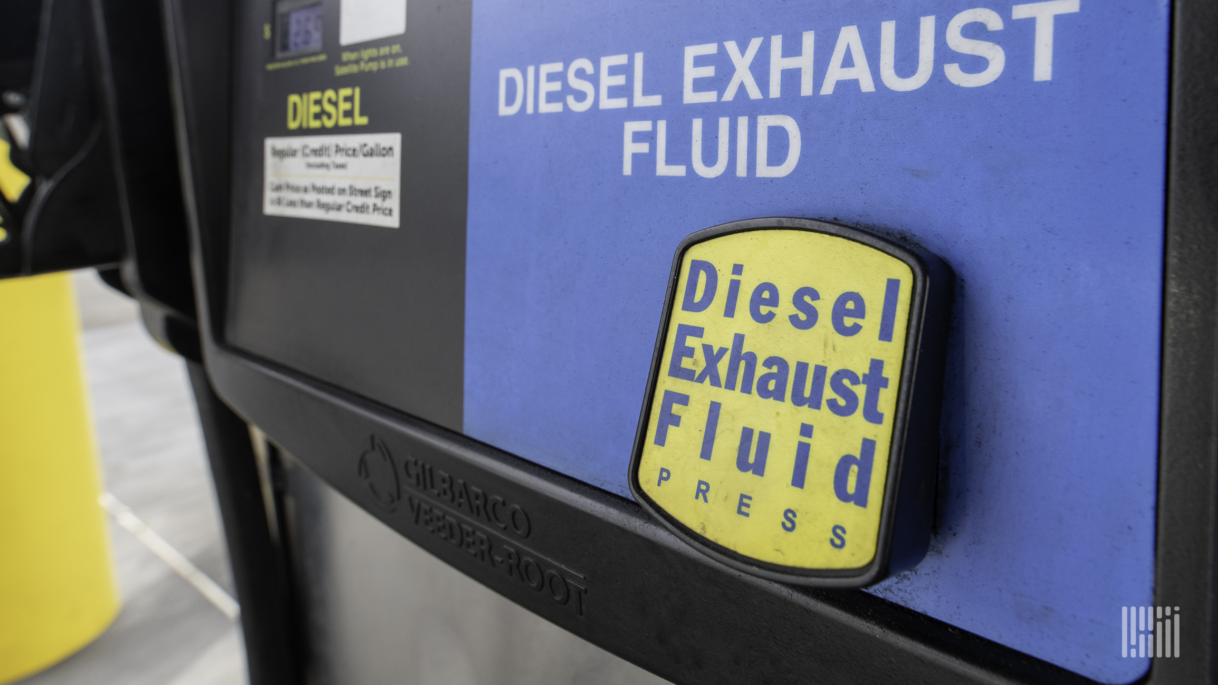

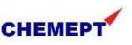
REPORT ON- Market and Business Environment Report— Diesel Exhaust Fluid (AdBlue)
Prepared By:
Prepared For:
www.chemanalyst.com
January 09, 2022

Slide 2
Report Content
Sl. No.
Report Content
Page No.
1
PRODUCT OVERVIEW
4
2
RESEARCH METHODOLOGY
6
3
EXECUTIVE SUMMARY
8
4
GLOBAL DIESEL EXHAUST FLUID (ADBLUE) MARKET OUTLOOK
11
5
INDIA DIESEL EXHAUST FLUID (ADBLUE) MARKET OUTLOOK
15
6
SUPPLY AND DEMAND ANALYSIS
37
7
IMPORT & EXPORT
38
8
PRICE BENCHMARKING
40
9
VALUE CHAIN ANALYSIS
42
10
COMPETITIVE LANDSCAPE
45

Slide 3
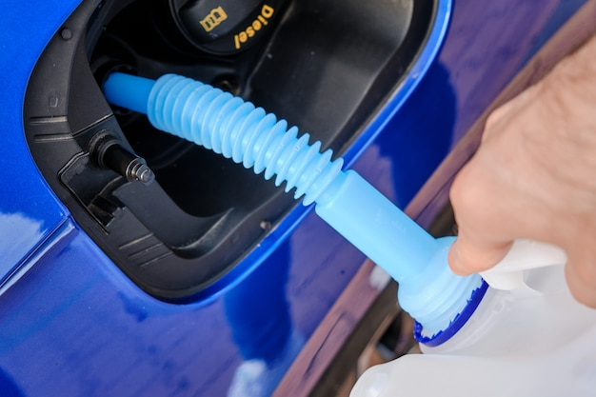
Diesel Exhaust Fluid (AdBlue)

Slide 4
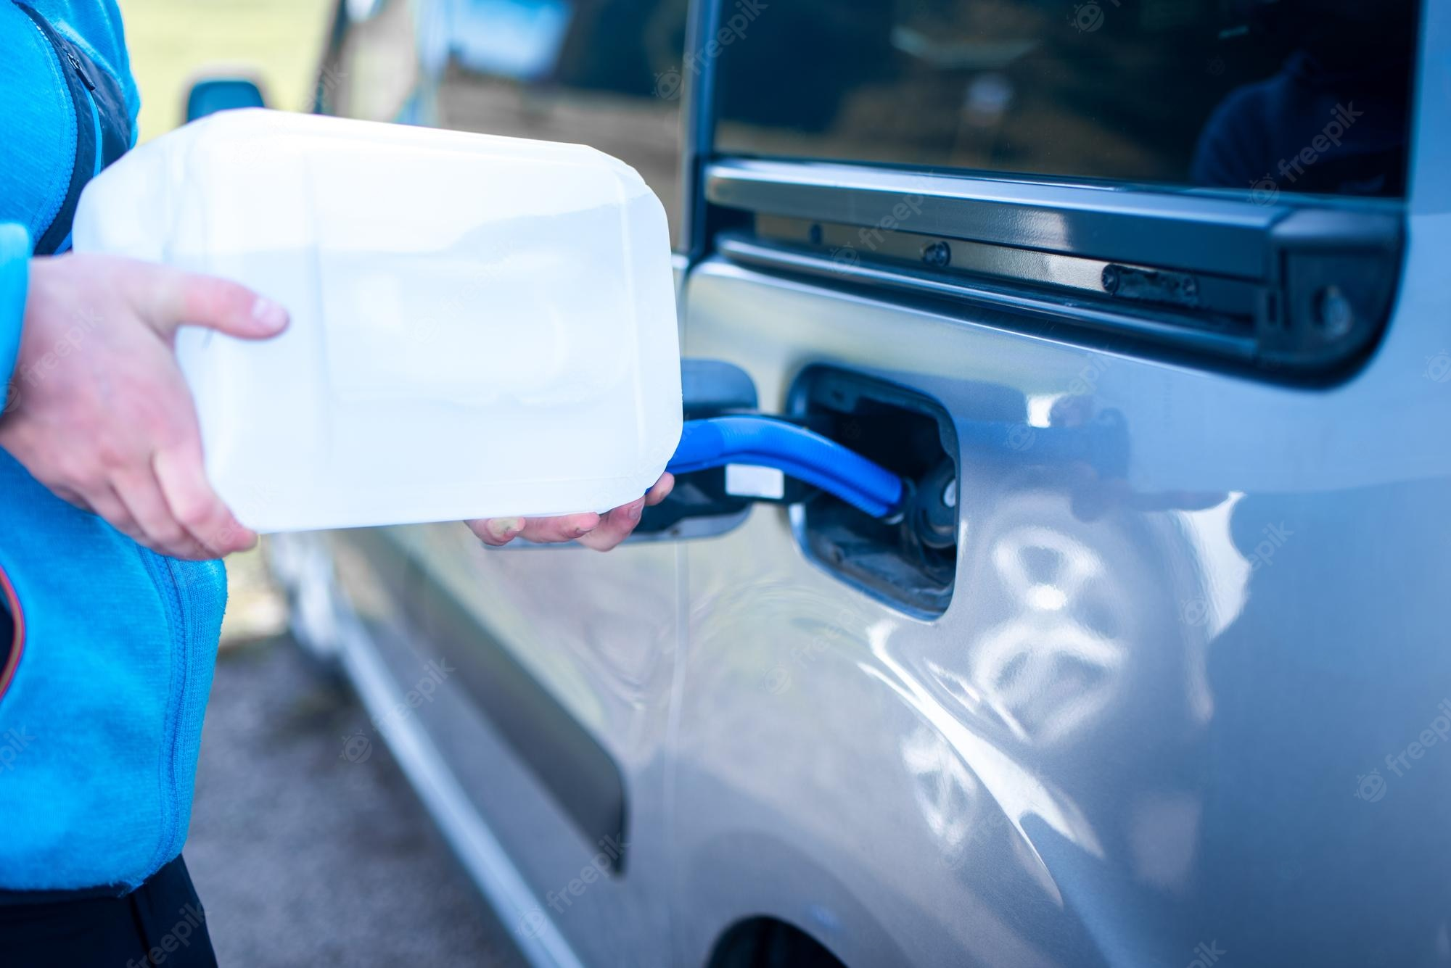

Product Overview- Diesel Exhaust Fluid (AdBlue)
AdBlue is a diesel exhaust fluid used in vehicles with Selective Catalytic Reduction (SCR) technology to reduce harmful gases being released into the atmosphere. AdBlue is a 32,5 % solution of high-purity, synthetically manufactured urea in de-mineralized water. It is a safe-to-use fluid.
AdBlue is used in vehicles with a Selective Catalytic Reduction catalyst, or SCR. An SCR catalyst ensures that exhaust gases are treated before they leave the vehicle. A large proportion of the heavy-duty vehicles complying with the Euro 4, Euro 5 and Euro 6 standards are equipped with an SCR system and therefore use AdBlue. This applies to most trucks after 2005; the first passenger cars with diesel engines and SCR were introduced in response to the Euro 6 standard in 2014.
AdBlue aims to significantly reduce emissions of nitrogen oxide (NOx) which are harmful to the environment and thus meet the stringent emission limits set by European standards (Euro 6) - which are standard for the control of emissions of new vehicles sold in the European Union and America.
AdBlue fluid treatment is injected into the exhaust gases and can filter out more than 90% of the harmful gas emissions of nitrogen oxide into steam and nitrogen, resulting in less pollution.

Slide 5

RESEARCH METHODOLOGY

Slide 6
Research Methodology
The methodology for this study was based on exhaustive Secondary Research followed by extensive Primary Research. ChemAnalyst deployed a dedicated team who worked dedicatedly for the Client to meet research objectives.
Phase-I: Secondary Search
The team conducted exhaustive secondary research to collect the information on required set of data /information
Phase-II: Formulating Questionnaire & Developing List of Respondents
Based on understanding developed though secondary search, ChemAnalyst team formulated a guideline and developed list of respondents to ask specific questions related with the project objectives for each type of stakeholders (Manufactures, Distributors/ Traders/ Exporters / Importers, Government/ Research/ Regulatory Organisations/ Associations and Industry experts.
Phase-III: Extensive Primary Search
ChemAnalyst executed primary surveys targeting key participants including industry experts through Telephonic/ Face to Face methodology. ChemAnalyst performed periodical checks on data being collected through field surveys with logic checks and analyze survey results.
We completed multiple interviews in one organisation at different levels (Mid-Senior) and departments (Sales, Marketing, Production, etc)
Phase-IV: Analysis of Information Developed and Submission of Report
ChemAnalyst completed the analysis of collected set of information for target products and summarized key findings to client in the form of Report

Slide 7
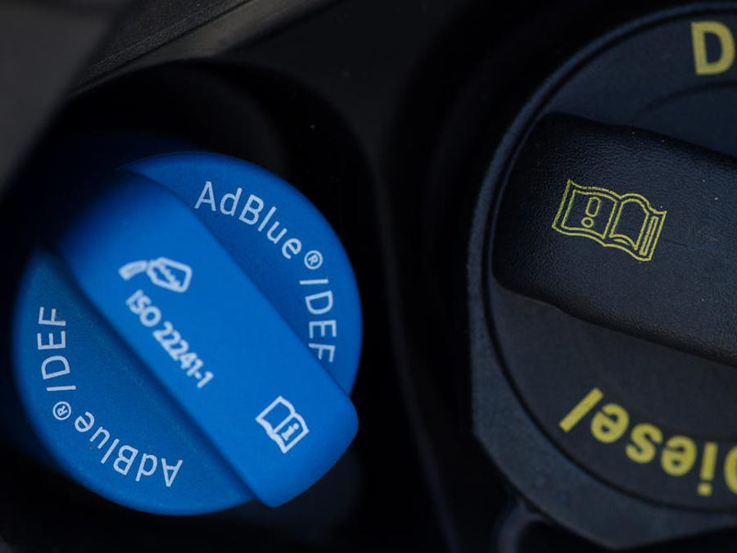
EXECUTIVE SUMMARY

Slide 8
Executive Summary
India Diesel Exhaust Fluid (AdBlue) Market Size, By Value (USD Billion), 2017, 2021, 2025F, 2030F, 2035F, 2040F
CAGR 2021-2027F
13.6%
India Diesel Exhaust Fluid market stood at USD 3.0 billion and is expected to reach USD 9.4 billion at a CAGR of 13.6% by 2030 and USD 27.5 billion by the end of 2040 at a CAGR of 11.4%.
CAGR 2030F-2040F
11.4%
CAGR 2017-2021
4.7%
Global Market 2017: 13.8 USD Billion
2021: 18 .4 USD Billion
2040: 88.8 USD Billion
India Diesel Exhaust Fluid (AdBlue) Market Size, By Volume (in Billion Litres), 2017, 2021, 2025F, 2030F, 2035F, 2040F
CAGR 2025E-2027F
11.1%
Initiatives such as “Make in India” and the PLI Scheme improve the manufacturing sector dynamics of India, and hence more industries are established.
CAGR 2017-2021
8.3%
CAGR 2025E-2027F
10.5%
Global Market 2017: 25.5 Billion Litres
2021: 30.7 Billion Litres
2040: 121.7 Billion Litres
Source: ChemAnalyst

Slide 9
Executive Summary
India Diesel Exhaust Fluid (AdBlue) Market, By Application, By Value (USD Billion), 2021 and 2040F
The rising environmental concern over the diesel and increase in awareness of the harmful emissions of diesel vehicles surge the market for Diesel Exhaust Fluid.
India Diesel Exhaust Fluid (AdBlue) Market, By Application, By Volume (Billion Litres), 2021 and 2040F
The demand for Diesel Exhaust Fluid from the automotive industry stood at USD 1.9 billion in 2021. Supportive government initiatives like adoption BS- VI norms enhance the demand for Diesel Exhaust Fluid in India.
Source: ChemAnalyst

Slide 10

Global Diesel Exhaust Fluid (AdBlue) Market Outlook

Slide 11
Global Diesel Exhaust Fluid (AdBlue) Market, By Value & Volume
Figure 1: Global Diesel Exhaust Fluid (AdBlue) Market Size, By Value (USD Billion) & By Volume (in Billion Litres), 2017, 2021, 2025F, 2030F, 2035F, 2040F
CAGR 2017-2021
By Value: 7.5%
CAGR 2021-2030F
By Value: 13.6%
CAGR 2030-2040F
By Value: 8.1%
CAGR 2017-2021
By Volume: 4.7%
CAGR 2021-2030F
By Volume: 7.9%
CAGR 2030-2040F
By Volume: 7.2%
Global Diesel Exhaust Fluid (AdBlue) market stood at USD 18 billion in 2021 and is expected to reach USD 41 billion at a CAGR of 9.3% by 2030 and 89 billion by the end of 2040 at a CAGR of 8.1%.
Due to rising auto manufacturing in nations like China and India, the Asia-Pacific region dominates the market for Diesel Exhaust Fluid (AdBlue).
The diesel exhaust fluid market is expanding as a result of the rising number of DEF pumps, rising average vehicle age, and rising mileage.
Source: ChemAnalyst

Slide 12
Global Diesel Exhaust Fluid (AdBlue) Market, By Value
Figure 2: Global Diesel Exhaust Fluid (AdBlue) Market, By Application, By Value (USD Billion), 2017, 2021, 2025F, 2030F, 2035F, 2040F
Total in USD Billion
14
18
29
41
61
89
Others: Mining, Generators etc..
Automotive segment holds largest share of overall demand, having a market share of more than 50%, and it stood at USD 9 billion in FY2021.
In the forecast period, it is expected that automotive segment will dominate the Diesel Exhaust Fluid (AdBlue) with a market share of over 50%.
The low cost of production and growing use of Adblue in farm equipment have further fueled the Indian Adblue Market, which is focused on agriculture.
Source: ChemAnalyst

Slide 13
Global Diesel Exhaust Fluid (AdBlue) Market, By Volume
Figure 3: Global Diesel Exhaust Fluid (AdBlue) Market, By Application, By Volume (Billion Litres), 2017, 2021, 2025F, 2030F, 2035F, 2040F
Total in Billion Litres
26
31
45
61
86
122
Others: Mining, Generators etc..
Source: ChemAnalyst

Slide 14
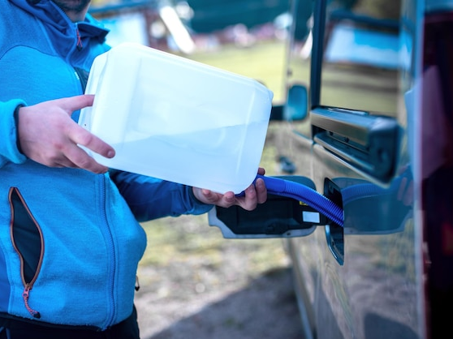
India Diesel Exhaust Fluid (AdBlue) Market Outlook

Slide 15
India Diesel Exhaust Fluid (AdBlue) Market, By Value & Volume
Figure 4: India Diesel Exhaust Fluid (AdBlue) Market Size, By Value (USD Billion) & By Volume (in Billion Litres), 2017, 2021, 2025F, 2030F, 2035F, 2040F
CAGR 2017-2021
By Value: 4.7%
CAGR 2021-2030F
By Value: 13.6%
CAGR 2030-2040F
By Value: 11.4%
CAGR 2017-2021
By Volume: 8.3%
CAGR 2021-2030F
By Volume: 11.05%
CAGR 2030-2040F
By Volume: 10.5%
India Diesel Exhaust Fluid (AdBlue) market stood at USD 3.0 billion in 2021 and is expected to reach USD 9.4 billion at a CAGR of 13.6% by 2030 and 27.5 billion by the end of 2040 at a CAGR of 11.4%.
The severe emission standards that are causing a greater penetration of diesel SCR cars and an increase in the number of DEF pumps are the main factors anticipated to fuel the growth of the diesel exhaust fluid market during the forecast period.
Increased demand for heavy-duty trucks, improved infrastructure, and ongoing industrialization have all significantly boosted the AdBlue market in India.
Source: ChemAnalyst

Slide 16
India Diesel Exhaust Fluid (AdBlue) Market, By Value
Figure 5: India Diesel Exhaust Fluid (AdBlue) Market, By Application, By Value (USD Billion), 2017, 2021, 2025F, 2030F, 2035F, 2040F
Total in USD Billion
2
3
5
9
17
28
Others: Mining, Generators etc..
Source: ChemAnalyst

Slide 17
India Diesel Exhaust Fluid (AdBlue) Market, By Volume
Figure 6: India Diesel Exhaust Fluid (AdBlue) Market, By Application, By Volume (Billion Litres), 2017, 2021, 2025F, 2030F, 2035F, 2040F
Total in Billion Litres
2
3
5
8
14
22
Others: Mining, Generators etc..
Source: ChemAnalyst

Slide 18
India Diesel Exhaust Fluid (AdBlue) Market, By Value
Figure 7: India Diesel Exhaust Fluid (AdBlue) Market, By Region, By Value (USD Billion), 2017, 2021, 2025F, 2030F, 2035F, 2040F
Total in USD Billion
2
3
5
9
17
28
Others: Mining, Generators etc..
Source: ChemAnalyst

Slide 19
India Diesel Exhaust Fluid (AdBlue) Market, By Volume
Figure 8: India Diesel Exhaust Fluid (AdBlue) Market, By Region, By Volume (Billion Litres), 2017, 2021, 2025F, 2030F, 2035F, 2040F
Total in Billion Litres
2
3
5
8
14
22
Others: Mining, Generators etc..
Source: ChemAnalyst

Slide 20
India Diesel Exhaust Fluid Market Share, By Company, By Volume, FY 2021
In Indian Diesel Exhaust Fluid (DEF) market, Indian Farmers Fertilizer Cooperative Limited (IFFCO) has the largest market share of 17.2% followed by Indian Oil Corporation limited (IOCL) stood at 14.9%.
Source: ChemAnalyst

Slide 21
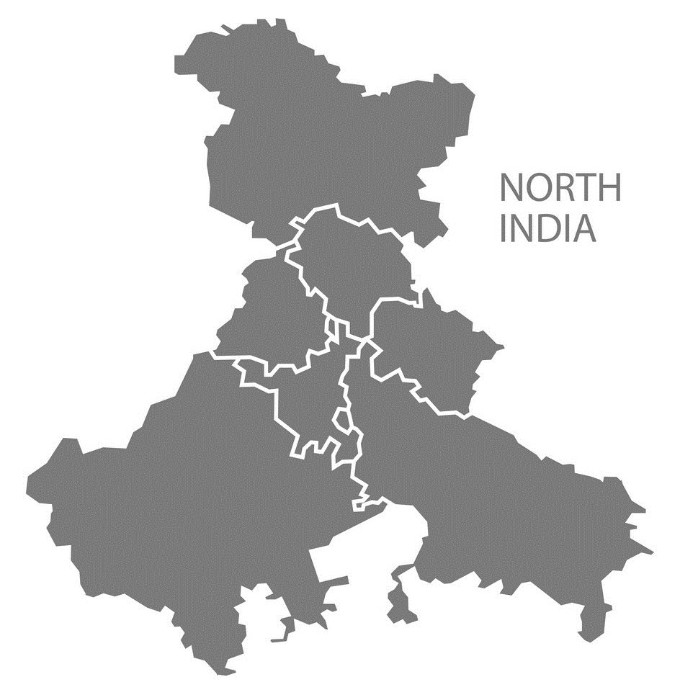
North India Diesel Exhaust Fluid (AdBlue) Market Outlook

Slide 22
North India Diesel Exhaust Fluid (AdBlue) Market, By Value & Volume
Figure 9: North India Diesel Exhaust Fluid (AdBlue) Market Size, By Value (USD Billion) & By Volume (in Billion Litres), 2017, 2021, 2025F, 2030F, 2035F, 2040F
CAGR 2017-2021
By Value: 5.0%
CAGR 2021-2030F
By Value: 13.7%
CAGR 2030-2040F
By Value: 11.3%
CAGR 2017-2021
By Volume: 8.6%
CAGR 2021-2030F
By Volume: 11.1%
CAGR 2030-2040F
By Volume: 10.4%
North India Diesel Exhaust Fluid (AdBlue) market stood at USD 0.8 billion in 2021 and is expected to reach USD 2.5 billion at a CAGR of 13.7% by 2030 and 7.2 billion by the end of 2040 at a CAGR of 11.3%.
To meet the rising demand for vehicle production in the nation, numerous manufacturers are investing in new manufacturing strategies and upgrading current facilities.
Like in July 2021, Maruti Suzuki India stated that it would invest INR 18,000 crore (USD 2.42 billion) in a new production facility in Haryana
Source: ChemAnalyst

Slide 23
North India Diesel Exhaust Fluid (AdBlue) Market, By Value
Figure 10: North India Diesel Exhaust Fluid (AdBlue) Market, By Application, By Value (USD Billion), 2017, 2021, 2025F, 2030F, 2035F, 2040F
Total in USD Billion
1
1
1
2
4
7
Others: Mining, Generators etc..
Source: ChemAnalyst

Slide 24
North India Diesel Exhaust Fluid (AdBlue) Market, By Volume
Figure 11: North India Diesel Exhaust Fluid (AdBlue) Market, By Application, By Volume (Billion Litres), 2017, 2021, 2025F, 2030F, 2035F, 2040F
Total in Billion Litres
1
1
1
2
3
5
Others: Mining, Generators etc..
Source: ChemAnalyst

Slide 25
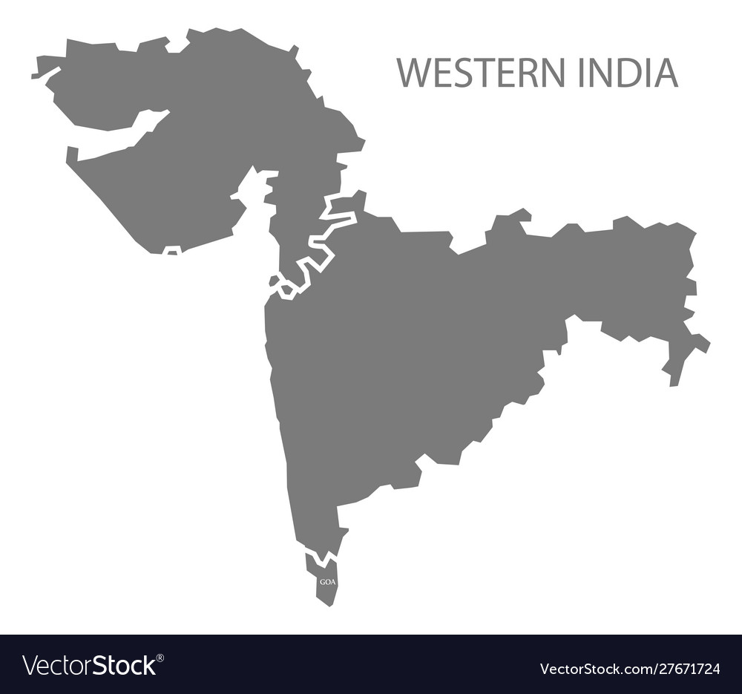
West India Diesel Exhaust Fluid (AdBlue) Market Outlook

Slide 26
West India Diesel Exhaust Fluid (AdBlue) Market, By Value & Volume
Figure 12: West India Diesel Exhaust Fluid (AdBlue) Market Size, By Value (USD Billion) & By Volume (in Billion Litres), 2017, 2021, 2025F, 2030F, 2035F, 2040F
CAGR 2017-2021
By Value: 4.7%
CAGR 2021-2030F
By Value: 13.6%
CAGR 2030-2040F
By Value: 11.4%
CAGR 2017-2021
By Volume: 8.4%
CAGR 2021-2030F
By Volume: 11.1%
CAGR 2030-2040F
By Volume: 10.5%
West India Diesel Exhaust Fluid (AdBlue) market stood at USD 1.0 billion in 2021 and is expected to reach USD 3.1 billion at a CAGR of 13.6% by 2030 and 9.2 billion by the end of 2040 at a CAGR of 11.4%.
The agro-focused Indian Adblue Market has also been fueled by low manufacturing costs and an increase in the use of Adblue in farm equipment.
The Government of India anticipates the vehicle sector to draw US$ 8–10 billion in domestic and international investments by 2023, therefore there have been a lot of investments recently.
Source: ChemAnalyst

Slide 27
West India Diesel Exhaust Fluid (AdBlue) Market, By Value
Figure 13: West India Diesel Exhaust Fluid (AdBlue) Market, By Application, By Value (USD Billion), 2017, 2021, 2025F, 2030F, 2035F, 2040F
Total in USD Billion
1
1
2
3
6
9
Others: Mining, Generators etc..
Source: ChemAnalyst

Slide 28
West India Diesel Exhaust Fluid (AdBlue) Market, By Volume
Figure 14: West India Diesel Exhaust Fluid (AdBlue) Market, By Application, By Volume (Billion Litres), 2017, 2021, 2025F, 2030F, 2035F, 2040F
Total in Billion Litres
1
1
2
3
5
7
Others: Mining, Generators etc..
Source: ChemAnalyst

Slide 29
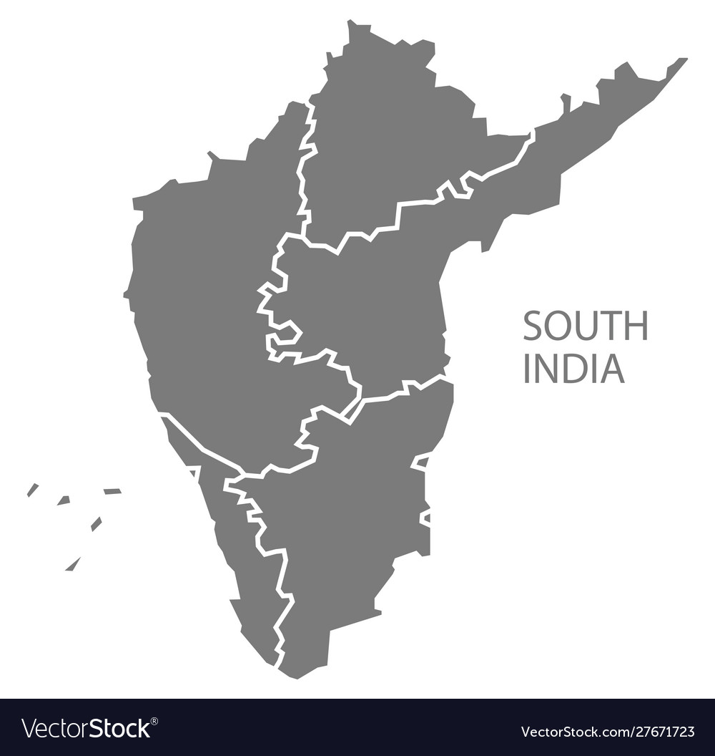
South India Diesel Exhaust Fluid (AdBlue) Market Outlook

Slide 30
South India Diesel Exhaust Fluid (AdBlue) Market, By Value & Volume
Figure 15: South India Diesel Exhaust Fluid (AdBlue) Market Size, By Value (USD Billion) & By Volume (in Billion Litres), 2017, 2021, 2025F, 2030F, 2035F, 2040F
CAGR 2017-2021
By Value: 4.7%
CAGR 2021-2030F
By Value: 13.6%
CAGR 2030-2040F
By Value: 11.4%
CAGR 2017-2021
By Volume: 8.4%
CAGR 2021-2030F
By Volume: 11.1%
CAGR 2030-2040F
By Volume: 10.5%
South India Diesel Exhaust Fluid (AdBlue) market stood at USD 1.0 billion in 2021 and is expected to reach USD 3.3 billion at a CAGR of 13.6% by 2030 and 9.7 billion by the end of 2040 at a CAGR of 11.4%.
In terms of volume, the South India Diesel Exhaust Fluid (AdBlue) market stood at 1.1 billion litres and is anticipated to reach 2.9 billion litres at a CAGR of 11.1% and 8.0 billion litres by the end of 2040 at a CAGR of 10.5%.
Incentives of US$ 3.5 billion are proposed by the Indian government as part of a revised programme to promote the production and export of clean technology vehicles over a five-year period until 2026.
Source: ChemAnalyst

Slide 31
South India Diesel Exhaust Fluid (AdBlue) Market, By Value
Figure 16: South India Diesel Exhaust Fluid (AdBlue) Market, By Application, By Value (USD Billion), 2017, 2021, 2025F, 2030F, 2035F, 2040F
Total in USD Billion
1
1
2
3
6
10
Others: Mining, Generators etc..
Source: ChemAnalyst

Slide 32
South India Diesel Exhaust Fluid (AdBlue) Market, By Volume
Figure 17: South India Diesel Exhaust Fluid (AdBlue) Market, By Application, By Volume (Billion Litres), 2017, 2021, 2025F, 2030F, 2035F, 2040F
Total in Billion Litres
1
1
2
3
5
8
Others: Mining, Generators etc..
Source: ChemAnalyst

Slide 33
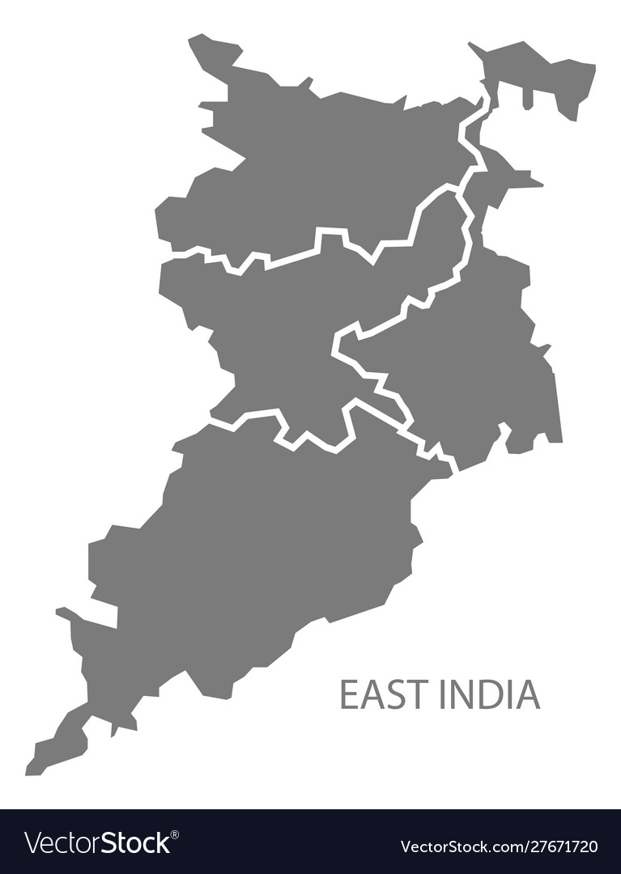
East India Diesel Exhaust Fluid (AdBlue) Market Outlook

Slide 34
East India Diesel Exhaust Fluid (AdBlue) Market, By Value & Volume
Figure 18: East India Diesel Exhaust Fluid (AdBlue) Market Size, By Value (USD Billion) & By Volume (in Billion Litres), 2017, 2021, 2025F, 2030F, 2035F, 2040F
CAGR 2017-2021
By Value: 2.9%
CAGR 2021-2030F
By Value: 12.8%
CAGR 2030-2040F
By Value: 11.3%
CAGR 2017-2021
By Volume: 5.5%
CAGR 2021-2030F
By Volume: 9.8%
CAGR 2030-2040F
By Volume: 10.1%
East India Diesel Exhaust Fluid (AdBlue) market stood at USD 0.2 billion in 2021 and is expected to reach USD 0.5 billion at a CAGR of 12.8% by 2030 and 1.4 billion by the end of 2040 at a CAGR of 11.3%.
Currently, there are only two production plant for commercial and passenger vehicles in the eastern region namely, Tata Motors (Jamshedpur, Jharkhand) and Hindustan Motors (Hindmotor, West Bengal).
Source: ChemAnalyst

Slide 35
East India Diesel Exhaust Fluid (AdBlue) Market, By Value
Figure 19: East India Diesel Exhaust Fluid (AdBlue) Market, By Application, By Value (USD Billion), 2017, 2021, 2025F, 2030F, 2035F, 2040F
Total in USD Billion
0.2
0.2
0.3
0.5
1
1
Others: Mining, Generators etc..
Source: ChemAnalyst

Slide 36
East India Diesel Exhaust Fluid (AdBlue) Market, By Volume
Figure 20: East India Diesel Exhaust Fluid (AdBlue) Market, By Application, By Volume (Billion Litres), 2017, 2021, 2025F, 2030F, 2035F, 2040F
Total in Billion Litres
0.1
0.1
0.2
0.3
0.4
1
Others: Mining, Generators etc..
Source: ChemAnalyst

Slide 37
Supply and Demand Analysis (Billion Litres), Planned Investment
Parameters | FY2017 | FY2019 | FY2021 | FY2025 | FY2030 | FY2035 | FY2040
Production | 1.8 | 2.2 | 2.1 | 2.7 | 3 | 3.2 | 3.5
Import | 0.5 | 1.0 | 1.1 | - | - | - | -
Export | 0.1 | 0.1 | 0.1 | - | - | - | -
Demand | 2.2 | 2.8 | 3.1 | 4.9 | 7.9 | 13.6 | 21.5
Surplus/Gap | - | - | - | -2.2 | -4.9 | -10.4 | -18.0
Existing Capacity | 2.5 | 2.8 | 2.8 | 3.3 | 3.7 | 3.7 | 3.7
Ex-Factory Price/Litre | 28 | 30 | 35 | - | - | - | -
In 2021, the overall production of Diesel Exhaust Fluid (AdBlue) in India stood at 2.1 Billion litres and had an existing capacity of 2.8 Billion litres.
Till now industry is operating at approximately 75% of the overall existing capacity.
The imports of Diesel Exhaust Fluid in India stood at 1.1 Billion litres in 2021. However, exports stood at 1.1 Billion litres in 2021.
Planned Investment
Indian Oil Corporation Limited (IOCL) | Currently, IOCL have 4 DEF plants, and they are planning to setup 5 more new plants
Indian Farmers Fertilizer Cooperative Limited (IFFCO) | IFFCO, has 1 manufacturing facility for DEF prodcution in Kalol, Gujarat. Instead of setting up greenfield plant, IFFCO did brownfield expansion of Kalol plant where manufacturing capacity of DEF (32.5% Urea Solution) is increased from 1,77,690 MTPA to 4,01,538 MTPA. whereas, for DEF (40% Urea Solution) capacity if increased from 1,44,375 MTPA to 3,26,250 MTPA.

Slide 38
Import & Export, By Volume
Export Top 5 Countries, By Volume (Billion Litres)
Import Top 5 Countries, By Volume (Billion Litres)
India exported 0.1 Billion Litres of Diesel Exhaust Fluid in FY 2021.
India exported majorly to Southeast Asian Countries like Nepal, Malaysia, Sri Lanka etc. .
India imported 1.1 Billion Litres of Diiesel Exhaust Fluid in FY 2021.
Imports of Diesel Exhaust Fluid majorly came from China, Oman, Ukraine, and United Arab Emirates.

Slide 39

Raw Material Price Benchmarking- Urea (INR/Kg) & Deionized water (INR/Litre), FY2018 – FY2025F
 |  | FY 2018 | FY 2019 | FY 2020 | FY 2021 | FY 2022 | FY 2023E | FY 2024F | FY 2025F
 | Urea FOB | 19.5 | 20.1 | 19.7 | 21.4 | 47.9 | 50.4 | 49.7 | 48.2
 | Deionized water | 30.3 | 31.7 | 34.4 | 35.5 | 42.8 | 43.1 | 43.4 | 43.8
India's fertilizer industry depends on imports, including raw materials and finished fertilizers sourced from various international sources.
Urea is currently sourced from Oman, countries in the Arabian Gulf, Southeast Asian nations like Indonesia, Vietnam, Malaysia, Singapore, and Russian ports in the Baltic Sea due to trade disruptions caused by the Ukraine-Russian conflict and restrictions on urea imports imposed by China since October 2021. As a result of this conflict, the cost of urea is soaring.
The commissioning of new plants in India is expected to bring down import dependency to less than half of current levels by FY 2025 although the
produced urea will be used primarily for the agriculture purpose.
The growing pharmaceutical and medical industries are primary driving force in deionized water, as high-purity water is essential in performing lab tests and many production processes.
The price of deionized water fluctuates concerning the demand in various industries like printing and publishing, mechanical and plating, power generation, etc.
The ongoing conflict between Russia and Ukraine and the impact of Covid-19 are expected to reduce its effect Post FY 2023. It will help to stabilize the price in FY 2024 and FY 2024 onwards
Source- ChemAnalyst
1
Source- ChemAnalyst

Slide 40
Diesel Exhaust Fluid Price Benchmarking (INR/Kg), FY2017 – FY2021,
Exports Price Benchmarking (INR/Kg), By Top 5 Countries, FY2017 – FY2021
Imports Price Benchmarking (INR/Kg), By Top 5 Countries, FY2017 – FY2021
Source- ChemAnalyst

Slide 41
Raw Material Price Benchmarking- Technical Grade Urea (INR/Kg), FY2018 – FY2025F
 | FY 2018 | FY 2019 | FY 2020 | FY 2021 | FY 2022 | FY 2023E | FY 2024F | FY 2025F
Technical Grade Urea | 35.8 | 37.3 | 36.6 | 38.4 | 48.9 | 60.3 | 58.1 | 55.7
Source- ChemAnalyst
The surge in the prices of technical grade urea is due to trade disruptions caused by the Ukraine-Russian conflict and restrictions on urea imports imposed by China since October 2021. Moreover, the impact of covid-19 has surged the prices of technical grade urea due to disruptions in the supply chain impacting the trade (Imports and Exports)
The ongoing conflict between Russia and Ukraine and the impact of covid-19 are expected to reduce its effect Post FY 2023. It will help to stabilize the price in FY 2024 and FY 2025 onwards.
1

Slide 42
Value Chain Analysis- Diesel Exhaust Fluid
Manufacturer/Producer
Margin: 10% to 13%
Margin: 10% to 15%
Distributor/Agents
Margin: 5% to 7%
Custom Duty: 10% , GST: 18%
End User
The profit margin for Diesel Exhaust Fluid manufacture is ranging from 10% to 15%. Whereas Distributor/Agents margin is between 5% to 7% .
Manufacturer while dealing directly with the end user take profit ranging from 10% to 15% depending upon the nature of contract that depends upon quantity, payment terms etc.

Slide 43
Market Dynamics
Drivers
The tight emission regulations that are causing selective catalytic reduction (SCR) to become more and more prevalent in diesel vehicles are the main driver fueling the market's expansion. By lowering the dangerous nitrogen oxide emissions from internal combustion engines, DEF functions as an anti-pollution chemical.
The need of sustainable agricultural methods has increased, which raises the need for cleaner fuel to power agricultural pumps and off-road machinery like tractors and combine harvesters. Therefore, the developing export markets for agricultural products along with the increasing population would promote the expansion of the DEF market in the upcoming years.
The market for diesel exhaust fluid will increase due to emerging economies and rapidly increasing in the passenger car owners.
Challenges
Since urea and deionized water make up DEF, the price of urea has some bearing on the cost of DEF. Since the supply and demand of the agricultural market directly affect the price of urea, it is very unpredictable. As a result, the global market for diesel engine exhaust gas treatment fluid will face challenges due to the price fluctuations of urea and DEF.
Electric car use is rising, which reduces environmental pollution, global warming, and dependence on petroleum. The government of India have created programs to raise public knowledge about environmental pollution, its health effects, and potential cures in response to the rise in pulmonary ailments brought on by dirty air. The government has launched a number of programs to promote the use and creation of electric vehicles.

Slide 44

COMPETITIVE LANDSCAPE

Slide 45
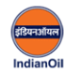
INDIAN OIL CORPORATION LTD (IOCL)
The company was established in 1959 as Indian Oil Company Ltd., Indian Oil Corporation Ltd was formed in 1964 with the merger of Indian Refineries Ltd. The company's corporate office is based in New Delhi.
IOCL AdBlue is a VDA certified and meets ISO 22241 specifications,
IndianOil's Diesel Exhaust Fluid (DEF), branded as IOC ClearBlue.
The company is also involved in the exploration and production of crude oil and gas; and marketing of natural gas and petrochemicals.
The company's products include LPG, aviation turbine fuel, bitumen, high speed diesel, bulk/industrial fuels, lubricants and greases, marine fuels and lubricants, gasoline, petrochemicals, kerosene oil, and crude oil.
Indian Oil also collaborated with Cummins for bulk dispensing of diesel exhaust fluid.
The company manufacture diesel exhaust fluid designed specifically for use in SCR systems to reduce NOx emissions.
North
West
East
South
Business Setup, FY2021
HQ | New Delhi
Plants | Gujarat, Barauni, Panipat and Guwahati
Key Indicators- Target Product
Plant Capacity | 250 MLPA
Production Volume, 2021 | 220 MLPA
Market Share, By Volume, FY 2021 | 14.9%
Key Indicators- Overall
Total Revenue, FY 2021 | INR 5,14,890 Crore
Profit After Tax (PAT) | INR 21,836 Crore

Slide 46
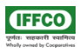
INDIAN FARMERS FERTILIZER COOPERATIVE (IFFCO)
Founded in 1967, Indian Farmers Fertilizer Cooperative Limited (IFFCO) is a multi-state cooperative society wholly owned by Cooperative Societies of India.
IFFCO houses five state-of-the-art production units located at
Kalol, Kandla, Phulpur, Aonla, and Paradeep, placed strategically for easy access to shipping docks and raw materials.
Out of the five plants of IFFCO, three plants are commissioned and are used in the making of DEF, Urea, and remaining plants are operated for the production of NPK/DAP & Phosphoric Acid Fertilizer.
The company manufacture Adblue by 100% Indigenous & Patented technology at IFFCO Kalol Unit, Gandhinagar (Gujarat).
IFFCO has also obtained license from VDA to used AdBlue Trademark.
The company manufacture DEF designed specifically for use in SCR systems to reduce NOx emissions.
North
West
East
South
Business Setup, FY2021
HQ | New Delhi
Plants | Kalol, Gujarat
Key Indicators- Target Product
Plant Capacity | 322 MLPA
Production Volume, 2021 | 300 MLPA
Market Share, By Volume, FY 2021 | 17.2%
Key Indicators- Overall
Total Revenue, FY 2021 | INR 533.69 Crore
Profit After Tax (PAT) | INR 2.85 Crore

Slide 47
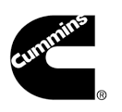
CUMMINS INC.
Cummins India Limited was established in 1962 and is a leading manufacturer of diesel and natural gas engines, generator in India.
The company also manufacturer adblue in India, designed specifically for use in SCR systems to reduce NOx emissions.
Cummins Genuine AdBlue® meets ISO 22241 specifications, VDA certified and is backed by the best warranty in the business.
The company has four zonal offices in Pune, Gurgaon, Kolkata and Bangalore and has area offices at 14 locations across India.
The operations are carried out at multiple facilities situated in Pune, Chennai, Pirangut, and also the company’s manufacturing locations are compliant with ISO 9001-2015 standards.
The company also exports its products to different countries like the USA, Europe, Mexico, Africa, the Middle East, and China.
The company has a total of 3,237 employees, as of March 31, 2021.
North
West
East
South
Business Setup, FY2021
HQ | Pune, Maharashtra
Plants | Pune, Maharashtra
Key Indicators- Target Product
Plant Capacity | 170 MLPA
Production Volume, 2021 | 140 MLPA
Market Share, By Volume, FY 2021 | 9.3%
Key Indicators- Overall
Total Revenue, FY 2021 | INR 4,256 Crore
Profit After Tax (PAT) | INR 808 Crore

Slide 48

HINDUSTAN PETROLEUM CORPORATION LIMITED (HPCL)
Hindustan Petroleum Corporation Limited is an Indian oil and gas refining company established in 1974 having it headquarter in Mumbai.
HPCL AdBlue is VDA certified and meets ISO 22241 & IS 17042 (Part 1) specifications,
The DEF manufactured is a non-toxic, high quality and highly pure Aqueous Urea Solution that works with SCR (Selective Catalytic Reduction) technology to chemically change harmful nitrogen oxide (NOx) emissions from heavy-duty diesel vehicles into harmless nitrogen and water.
HP DEF is recommended for modern Commercial Vehicles (Trucks & Buses), Diesel SUVs and any other BS IV / VI or (Euro IV/V/VI) compliant diesel engines employing SCR / EGR-SCR technology for NOx reduction.
HP DEF (Diesel Exhaust Fluid) became a significant volume builder brand with sales crossing 12.5 TMT – the highest among OMCs
The company has a total of 10,000 employees, as of March 31, 2021.
The company also exports its products to different countries like the Europe, Africa, and the Middle East.
North
West
East
South
Business Setup, FY2021
HQ | Mumbai, Maharashtra
Plants | Mumbai, Maharashtra
Key Indicators- Target Product
Plant Capacity | 150 MLPA
Production Volume, 2021 | 125 MLPA
Market Share, By Volume, FY 2021 | 8.3%
Key Indicators- Overall
Total Revenue, FY 2021 | INR 52,589 Crore
Profit After Tax (PAT) | INR 403.60 Crore

Slide 49
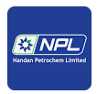
NANDAN PETROCHEM LIMITED
North
Overview:
Nandan Petrochem Limited was established in the year 1992 in Mumbai.
According to the company, it is one of the top producers of genuine oils, greases, and specialty oils with a sizable domestic and international presence in the lubricating oil market. It is constantly pursuing innovation to increase stakeholder value and customer happiness.
NPL began its business by combining and filing contracts for public sector undertakings.
The business was the oldest and largest contract manufacturer in the nation, and it also had a technical partnership arrangement with Meguin GmbH (Germany).
The full product line, including lubricants, greases, transformer oil, white oil/liquid paraffin, rubber process oils, and speciality lubricants, is being marketed by NPL under the "VELVEX" brand. NPL has access to the most recent technology.
The company has a strong client base that includes Daimler, Mahindra, Ford, Tata, Mercedes etc.
West
East
South
Business Setup, FY2021
HQ | Mumbai, Maharashtra
Plants | Mumbai, Maharashtra
Key Indicators- Target Product
Plant Capacity | 100 MLPA
Production Volume, 2021 | 83 MLPA
Market Share, By Volume, FY 2021 | 5.3%
Key Indicators- Overall
Total Revenue, FY 2021 | INR 380 Crore
Profit After Tax (PAT) | INR 17 Crore

Slide 50

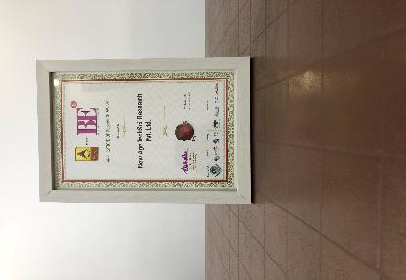
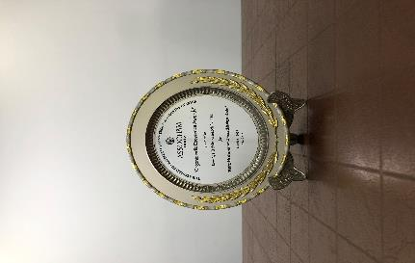

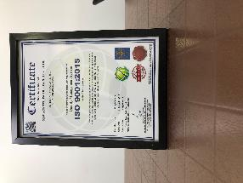

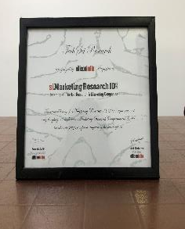
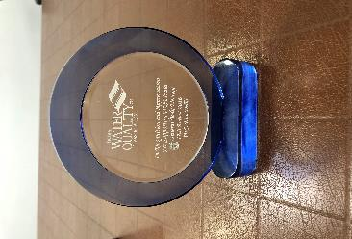

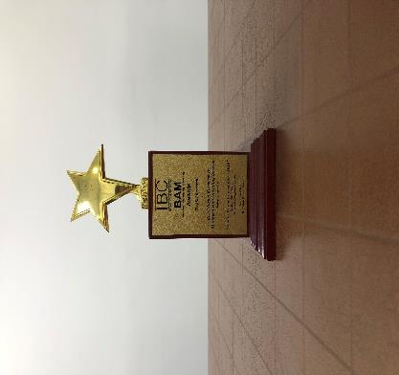
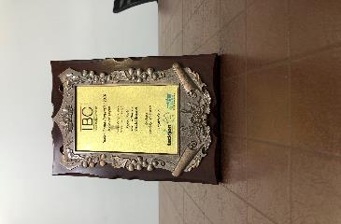

ChemAnalyst- Awards & Recognition
Best Application of Research Award at World Marketing Congress by ABP News ( 2018 )
Organic India Excellence Awards by ASSOCHAM India (2018)
Business-to-Business Research Award at Brand Excellence Awards by ABP News (2018)
Quality Management System by ISO (2018)
Best Application of Research Award at World Marketing Congress by ABP News ( 2017 )
Award for Best Place to Work in Research at World Marketing Congress by ABP News (2017)
Recognition from Silicon India Magazine
Recognition & Appreciation from WQIA
Best Market Research & Management Consulting Manufacturing Processby Wafisilpa Entertainments
Leadership Award from World Marketing Congress
Leadership Award from World Marketing Congress

Slide 51





























Our Prestigious Clients Who Bought Reports in Chemical Industry

Slide 52


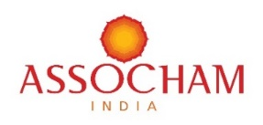




Disclaimer :
The contents of this report are based on information generally available to the public from sources and primary interviews which are believed to be reliable. No representation is made that it is timely, accurate or complete. TechSci Research has taken due care and caution in compilation of data as this has been obtained from various sources including primary interviews which it considers reliable and firsthand. However, TechSci Research does not guarantee the accuracy, adequacy or completeness of any information and it is not responsible for any errors or omissions or for the results obtained from the use of such information and especially states that it has no financial liability whatsoever to the subscribers / users of this report. The information herein, together with all estimates and forecasts, can change without notice. All the figures provided in this document are indicative of relative market size and are strictly for client’s internal consumption. Usage of the same for purpose other than internal will require prior approval of TechSci Research.
CONTACT US
TechSci Research – North America
2950, Boundary Road, Burnaby, British Columbia, Canada
Tel: +1- 646- 360-1656
E: sales@techsciresearch.com
TechSci Research – Europe
54, Oldbrook, Bretton,
Peterborough,
United Kingdom
E: sales@techsciresearch.com
TechSci Research – Asia-Pacific
B-44, Sector -57, Noida, National Capital Region, UP, India
Tel: +91-120-4523900
E: sales@techsciresearch.com
TechSci Research
Cyber City, Building No. 8C, Gurgaon, National Capital Region, Haryana, India
Tel: +91-124-6428661
E: sales@techsciresearch.com
www.techsciresearch.com
INDUSTRY ASSOCIATIONS
The information contained herein is of a general nature and is not intended to address any particular situation, individual or entity. No one should act upon such information without appropriate professional advice.
2021 © TechSci Research All Rights Reserved.

